Slide 1
Netflix Movies and TV Shows Exploratory Data Analysis
VINAY SAI RANGUMURI
BATCH NO. 8
INTERNSHIP BATCH – 3
rangumudrivinaysai2001@gmail.com

Slide 2
Netflix Movies and TV Shows EDA 🍿
Netflix is the world’s leading premium media streaming platform, hosting thousands of films and TV series in nearly 200 countries and territories. Initially, a mail-order DVD rental service launched in 1997, the company quickly dominated the streaming sphere when it launched its subscription video-on-demand service a decade later in 2007, the same year that Hulu launched. The field has become quite a bit more crowded since then, and Netflix now competes with the likes of Amazon Prime Video, HBO Max, Disney Plus, Apple TV Plus, and many more, including niche streamers like The Criterion Channel and Shudder.

Slide 3
Project Overview:
This project aims to analyze the content available on netflix streaming platform. The study will analyze the different content available across different countries and its content creators.

Slide 4
Objective:
The Objective of the project is to identify the content types available on netflix, across different countries, types of content available with similarity, top actors appearing in most contents, top directors creating most content and what netflix is focusing on in recent years w.r.t Movies or Tv shows.

Slide 5
Methodology:
Involves the following steps:
Business Understanding
Data Understanding
Data Preparation
Data Exploration

Slide 6
Business Understanding
The main questions that we have to answer in this notebook
Understanding what content is available in different countries
Identifying similar content by matching text-based features
Network analysis of Actors / Directors and find interesting insights
Does Netflix has more focus on TV Shows than movies in recent years

Slide 7
Data Understanding
Explored the data using pandas DataFrame
Identified the patterns and relationship between
columns type, director, cast, country e.t.c

Slide 8
Data Preparation
Performed data cleaning by removing missing values.
Transformed the data by separating multiple values in the columns by splitting the data column wise.
Used text pre-processing technique on column containing data in details or in sentences to transform the data to find similar words or most common words for example column “description” in this data.

Slide 9
Data Exploration
Explored the data from previous Data preparation stage using identified patterns and relationships
Python libraries used Matplotlib, WordCloud.
Tableau used for visualization from data prepared using python.

Slide 10
ANALYSIS

Slide 11
Exploratory Data Analysis
# Data analysis
import numpy as np
import pandas as pd
# Visualization
import seaborn as sns
import matplotlib.pyplot as plt
import plotly.express as px
from wordcloud import WordCloud,STOPWORDS

Slide 12
Exploratory Data Analysis
# Checking Shape of the data
netflix_overall=pd.read_excel("netflix_titles1.xlsx")
netflix_overall.head()
About the 12 columns of this interesting dataset:
show_id: A unique ID for each show
type: The category of a show — it can be Movie or TV Show
title: Name of the show
director: Name of the director(s) of the show
cast: Actors involved in the show
country: Country where the show was produced
date_added: Date when the show was added on Netflix
release_year: Release year of the show
rating: TV rating — a content rating system
duration: Time duration — in minutes or number of seasons
listed_in: Genre(s)
description: A summary of the show
Checking Shape of the data → (8807, 12)

Slide 13
Exploratory Data Analysis
Checking Shape of the data → (8807, 12)
No of Columns present in the Dataset →
Index(['show_id', 'type', 'title', 'director', 'cast', 'country', 'date_added',
'release_year', 'rating', 'duration', 'listed_in', 'description'],
dtype='object')
Missing data
director null rate: 29.91%
cast null rate: 9.37%
country null rate: 9.44%
date_added null rate: 0.11%
rating null rate: 0.05%
duration null rate: 0.03%
5 columns have missing values, with Director missing 1/3 of the time

Slide 14
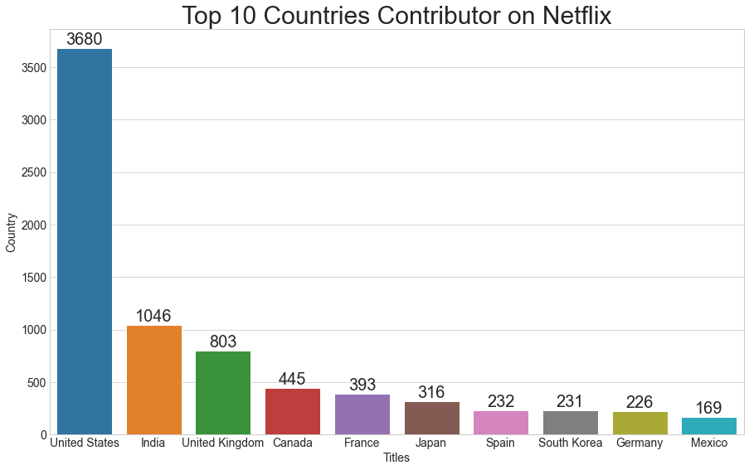
Understanding what content is available in different countries
Country Count
United States 3680
India 1046
United Kingdom 829
Canada 418
France 243
Japan 199
Spain 181
South Korea 145
Germany 124
Mexico 110
Name: country, dtype: int64

Slide 15
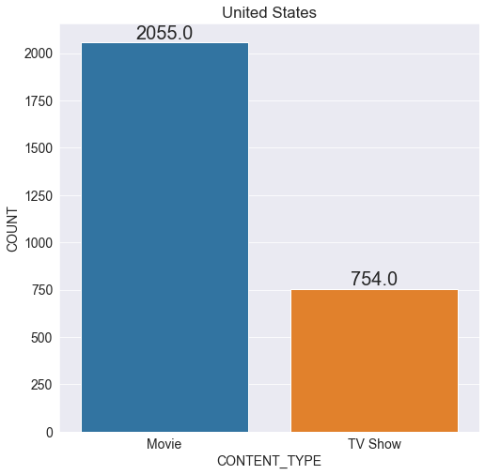
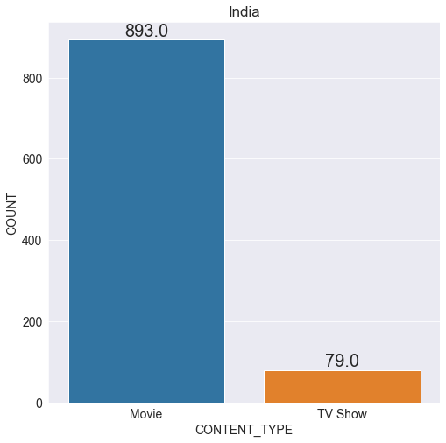
Understanding what content is available in different countries
United States
India

Slide 16

Identifying similar content by matching text-based features
text = " ".join(description for description in netflix_overall.description)
word_cloud = WordCloud(collocations = False, background_color = 'white').generate(text)
plt.figure(figsize = (20, 10))
plt.imshow(word_cloud, interpolation = 'bilinear')
plt.axis("off")
plt.show()

Slide 17
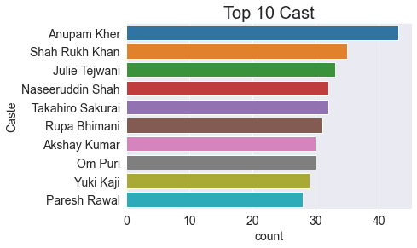
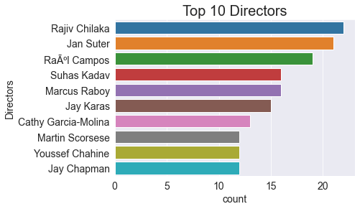
Network analysis of Actors / Directors and find interesting insights
TOP 10 ACTORS (CAST)
TOP 10 DIRECTORS

Slide 18
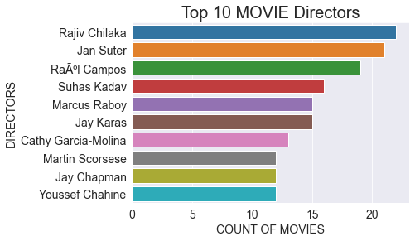
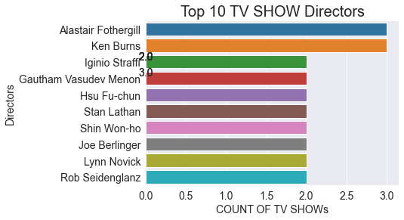
Network analysis of Directors
TOP 10 DIRECTORS IN MOVIES
TOP 10 DIRECTORS IN SHOWS

Slide 19
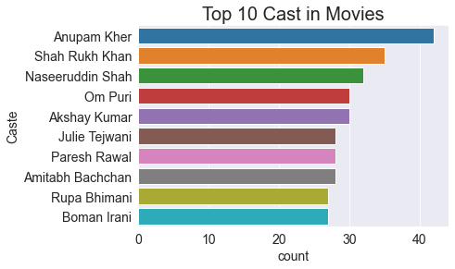
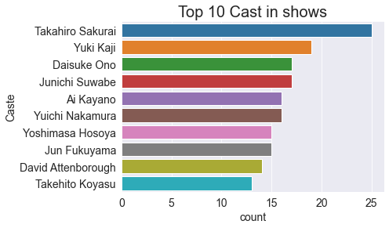
Network analysis of Actors
TOP 10 CAST IN MOVIES
TOP 10 CAST IN SHOWS

Slide 20
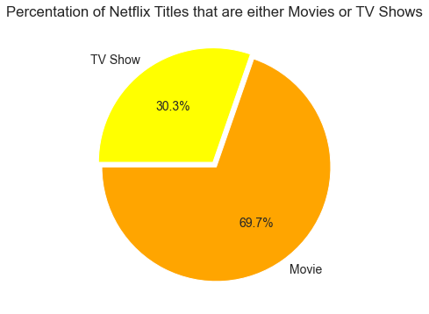
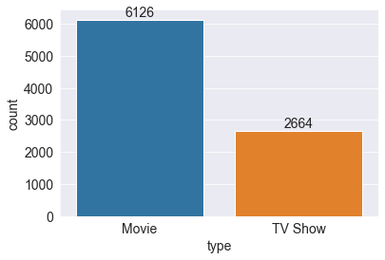
Does Netflix has more focus on TV Shows than movies in recent years
PIE CHART PERCENTAGE INFORMATION
BAR CHART COUNT INFORMATION

Slide 21
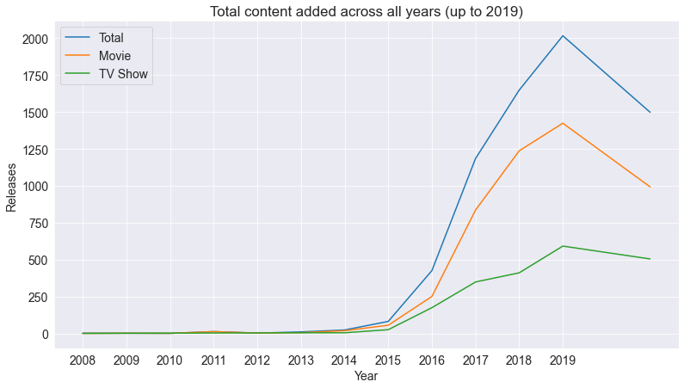
Does Netflix has more focus on TV Shows than movies in recent years

Slide 22
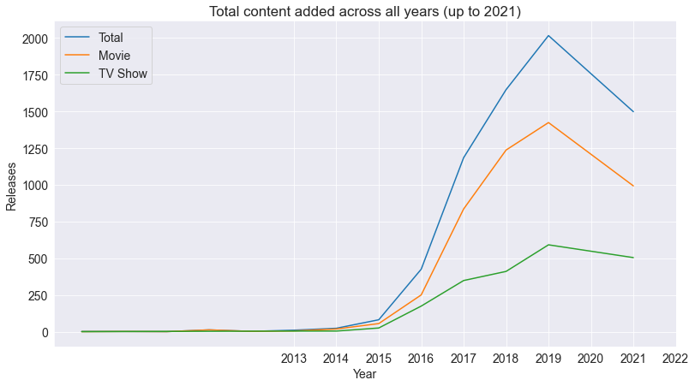
Does Netflix has more focus on TV Shows than movies in recent years
FROM 2013 TO 2021 Observe ( movies completely down, TV shows slant decrease)

Slide 23
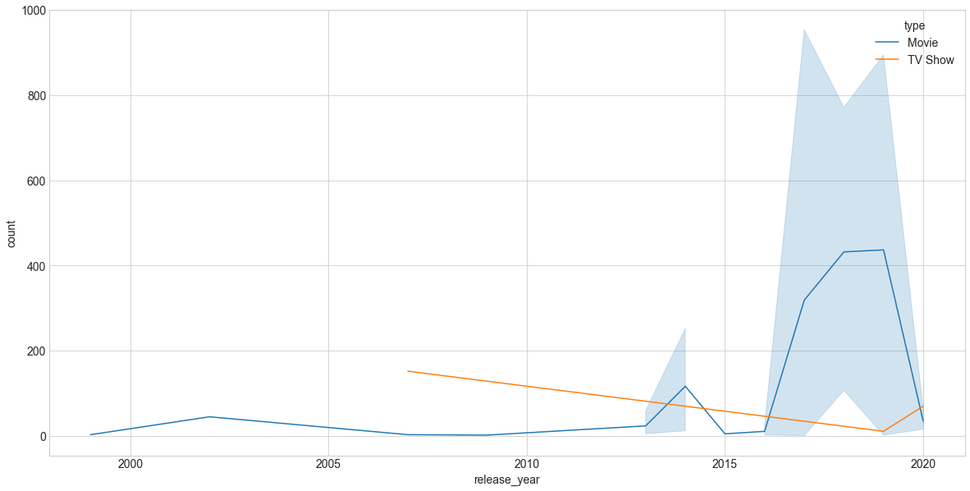
Does Netflix has more focus on TV Shows than movies in recent years
Slant increment of TV shows will be observed in the graph

Slide 24
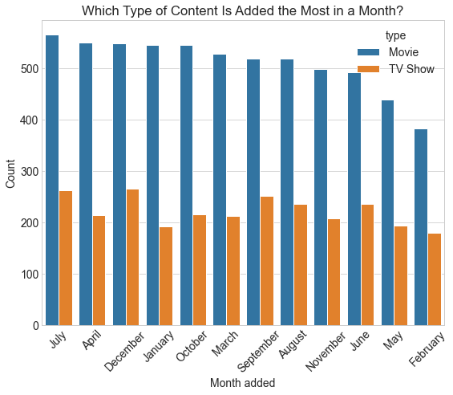
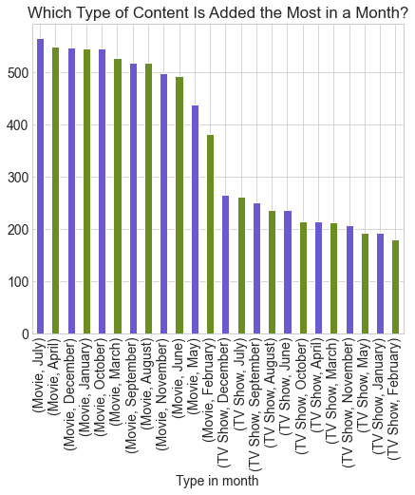
Does Netflix has more focus on TV Shows than movies in recent months
CONTENT ADDED THE MOST IN A MONTH
CONTENT ADDED THE MOST IN A MONTH

Slide 25
THE END

